Slide 1



DEPARTMENT OF INFORMATION SCIENCE AND ENGINEERING
MAJOR PROJECT PHASE II PRESENTATION
ON
“AI-Powered Resume Screening And Ranking System”
PRESENTED BY
MITHILA R 1VK22IS034
SNEHA K 1VK22IS052
YASHASWINI R 1VK23IS062
UNDER THE GUIDANCE Of
Prof. CHANDRAKALA V
ASSISTANT PROFESSOR, DEPT OF ISE-VKIT
https://vitb.ac.in/

Slide 2
AGENDA
Introduction
Literature Survey
Problem Statment
Objectives
Methodology
Architectural Design
Implementation details of modules
Data flow Diagram
Interface Diagram
Test case with results
Results
Conclusions
References
DEPT OF ISE, VKIT

Slide 3
INTRODUCTION
Hiring teams receive hundreds of resumes for every opening, and screening them manually is slow, inconsistent and hard to scale.
Most Applicant Tracking Systems (ATS) only count keyword matches, so they reward keyword stuffing and cannot tell that FastAPI and Flask are related skills.
Automated screening is also under scrutiny for bias, and the EU AI Act treats recruitment AI as high-risk, so every decision must be explainable.
In this project we developed an explainable, bias-aware screening system that ranks candidates on seven weighted signals, hides identity during scoring and gives a reason for every verdict.
DEPT OF ISE, VKIT

Slide 4
PROBLEM STATEMENT
Keyword-based ATS tools, like our Phase 1 system, only answer whether a resume contains the words of a job description. They cannot judge whether a skill claim is backed by evidence, they give no explanation when a candidate is rejected, and they can carry hidden bias from names and personal details. As a result, recruiters lose good candidates, trust inflated resumes and cannot justify their decisions. There is a need for a screening system that is accurate, explainable and bias-aware, so that hiring decisions are fair, consistent and auditable.
DEPT OF ISE, VKIT

Slide 5
LITERATURE SURVEY
Sl.No | Title | Author | Contribution | Drawback
1 | FA*IR: A Fair Top-k Ranking Algorithm | M. Zehlike, F. Bonchi, C. Castillo, S. Hajian, M. Megahed, R. Baeza-Yates (2017) | A re-ranking algorithm that keeps the top-k results fair to a protected group. | Needs protected attributes at ranking time and does not explain why a candidate received a score.
2 | Enhancing Person-Job Fit for Talent Recruitment: An Ability-Aware Neural Network Approach | C. Qin, H. Zhu, T. Xu, C. Zhu, L. Jiang, E. Chen, H. Xiong (2018) | A neural network that learns the abilities a job requires and matches them with the abilities shown in a resume, improving person-job fit prediction. | The learned model gives a match score without a human-readable reason and needs large amounts of historical hiring data.
DEPT OF ISE, VKIT

Slide 6
Sl.No | Title | Author | Contribution | Drawback
3 | Sentence-BERT: Sentence Embeddings using Siamese BERT-Networks | N. Reimers, I. Gurevych (2019) | Produces fast sentence embeddings that capture meaning, so "built REST services" matches "developed HTTP APIs". | A general text-similarity tool; it needs extra logic for skills, experience and fair decision-making.
4 | End-to-End Resume Parsing and Finding Candidates for a Job Description Using BERT | V. Bhatia, P. Rawat, A. Kumar, R. R. Shah (2019) | Extracts structured fields from resumes with BERT and ranks candidates against a job description in one pipeline. | Produces single similarity score, with no skill-gap breakdown and no check for bias.
5 | Mitigating Bias in Algorithmic Hiring: Evaluating Claims and Practices | M. Raghavan, S. Barocas, J. Kleinberg, K. Levy (2020) | Examines the bias-mitigation claims made by hiring-algorithm vendors and evaluates them against technical and legal requirements. | An analysis of existing practice; it does not implement a screening system.
DEPT OF ISE, VKIT

Slide 7
Sl.No | Title | Author | Contribution | Drawback
6 | A Comprehensive Survey of Artificial Intelligence Techniques for Talent Analytics | C. Qin, L. Zhang, Y. Cheng, R. Zha, D. Shen, Q. Zhang, X. Chen, Y. Sun, C. Zhu, H. Zhu, H. Xiong (2023) | Surveys AI techniques used across talent analytics, such as recruitment, including matching and ranking methods. | A survey; it does not provide an implemented, explainable and bias-aware screening pipeline.
7 | Improving Factuality and Reasoning in Language Models through Multiagent Debate | Y. Du, S. Li, A. Torralba, J. B. Tenenbaum, I. Mordatch (2024) | Several language-model agents debate and refine their answers, which improves reasoning and reduces errors. | Studied on general reasoning tasks, not on hiring decisions, and costs more computation.
8 | The Silicon Ceiling: Auditing GPT's Race and Gender Biases in Hiring | L. Armstrong, A. Liu, S. MacNeil, D. Metaxa (2024) | Shows that GPT-based hiring prompts can produce race- and gender-biased outcomes. | An audit only; no bias mitigation is built into a working pipeline.
DEPT OF ISE, VKIT

Slide 8
Sl.No | Title | Author | Contribution | Drawback
9 | Gender, Race, and Intersectional Bias in Resume Screening via Language Model Retrieval | K. Wilson, A. Caliskan (2024) | Audits language-model resume retrieval and shows that it can favour some names and groups over others. | An audit only; it does not propose a screening system that removes the bias.
10 | Comparing BERT and Sentence-BERT for Automated Resume Screening | A. Deshmukh, A. R. Dahake (2025) | Compares BERT and Sentence-BERT embeddings for matching resumes to job descriptions. | Evaluates similarity quality only; explanation of the result and fairness are not addressed.
DEPT OF ISE, VKIT

Slide 9
OBJECTIVES
1. Design: An explainable screening workflow that shows why every candidate was ranked and which skills are missing
2. Implement: A hybrid ranker that combines skills, semantic fit, experience, education, projects, certifications and resume quality.
3. Build: A skill-synonym ontology with skill-gap analysis that shows matched, partial and missing skills.
4. Minimize:Bias with a blind-screening mode that hides names and personal details before any scoring.
5. Accomplish: Fast, auditable hiring decisions through a four-agent review council and a FastAPI service.
DEPT OF ISE, VKIT

Slide 10
METHODOLOGY
1. Input: Job description + resumes (PDF, DOCX, TXT, scanned)
2. Parsing: skills, experience, education and projects are extracted.
3. Blind Screening: name and personal details are hidden.
4. Skill Ontology: synonyms and partial skill matches.
5. Hybrid Ranking: seven weighted scores give the match %.
6. Council Review: four agents score and debate.
7. Explainable Verdict: score, red flags and rationale.
8. Recruiter Dashboard: leaderboard, compare and export.
Audit: every stage is logged in the screening history, so each ranking can be audited later.
1 Input
2 Parsing
3 Blind Screening
4 Skill Ontology
5 Hybrid Ranking
6 Council Review
7 Explainable Verdict
8 Recruiter Dashboard
DEPT OF ISE, VKIT

Slide 11
ARCHITECTURAL DESIGN
Presentation layer
React web app (Nexus ATS, Vercel) | Streamlit recruiter workspace | Recruiter dashboard: leaderboard, interview kit, chatbot
Service layer
FastAPI REST service: screening engine and accounts (Render)
Secure sign-in: hashed passwords, 7-day sessions, Google verified on the server
Intelligence engine
Resume parser (PDF, DOCX, TXT, OCR) | Skill ontology | Hybrid ranker (7 weighted scores)
Four-agent council | Interview kit (20+ questions)
Data layer
MongoDB Atlas: accounts, sessions, candidate pools | SQLite: screening runs, audit trail | Job roles: required and preferred skills
DEPT OF ISE, VKIT

Slide 12
IMPLEMENTATION
Job Description
pasted by the recruiter
Resume Upload
PDF, DOCX, TXT, scanned (OCR)
Input: the job description and resumes are parsed into structured profiles.
Fairness: blind screening hides identity before any scoring.
Scoring: the ontology feeds a ranker that blends seven signals.
Decision: four agents score, debate and give a verdict with red flags.
Output: leaderboard, skill gap, a 20-question interview kit and a chatbot; the engine is served through FastAPI, with accounts and candidate pools in MongoDB Atlas.
JD Parser
required and preferred skills
Resume Parser
skills, experience, education, projects
Blind Screening (optional)
names and contact details replaced by Candidate #00N
Skill Ontology
synonyms, partial credit
Hybrid Ranker
7 weighted scores = match %
Four-Agent Council
Tech Lead, Culture, Fair Auditor, Seniority
Verdict + Dashboard
skill gap, interview kit, chatbot
DEPT OF ISE, VKIT

Slide 13
HYBRID RANKING MODEL
Match % is the weighted sum of seven scores, each from 0 to 100.
Skills (35%): required skills are matched through the ontology; related skills get partial credit (FastAPI through Flask counts 0.5).
Semantic fit (20%): TF-IDF and BM25 offline, Sentence-BERT when installed.
Evidence weighting: a skill that is listed but never shown in a project or result counts for less.
Flags: experience deficit, skill stuffing and date inconsistency lower the verdict.
DEPT OF ISE, VKIT

Slide 14
FOUR-AGENT COUNCIL AND EXPLAINABILITY
Tech Lead: checks skill coverage, evidence and architecture signals.
Culture: judges stability and retention risk.
Fair Auditor: checks that the decision is neutral and bias-free.
Seniority and Compensation: compares experience with the role level.
Consensus: the agents cross-examine each other, then give one verdict (Strong Hire, Lean Hire or Reject) with red flags and a debate transcript.
DEPT OF ISE, VKIT

Slide 15
DATA FLOW DIAGRAM
Resume screening flow:
Recruiter signs in, uploads JD + resumes
The recruiter signs in and uploads the job description and the resumes.
Each resume is parsed into skills, experience, education, projects and certifications.
Blind screening, when switched on, hides the name and personal details.
Every candidate is scored on seven signals using the skill ontology.
The four-agent council reviews the scores and gives a verdict with red flags.
Results are shown on the dashboard, and the API also saves them to the screening history.
Resume parsing
Blind screening (optional)
Scoring on 7 signals
Council verdict + flags
Dashboard + saved history
DEPT OF ISE, VKIT

Slide 16
Council decision flow:
Scored candidate profile
The scored candidate profile, anonymised when blind screening is on, is sent to the council.
Four agents score it independently: Tech Lead, Culture, Fair Auditor and Seniority.
The agents debate and cross-examine each other's findings.
A consensus score and a confidence value are calculated.
The verdict (Strong Hire, Lean Hire or Reject) is issued with red flags and a rationale.
Low-confidence cases are marked for human review.
Tech Lead
Culture
Fair Auditor
Seniority
Debate and cross-examination
Consensus score + confidence
Verdict + red flags
Low confidence: human review
DEPT OF ISE, VKIT

Slide 17
TEST CASES WITH RESULTS
No. | Test case | Scenario | Expected result | Actual result | Result
1 | Gold Standard | Strong ML engineer, evidence of results | Rank 1, match 85% or more, STRONG HIRE, no red flags | Rank 1, 88.1%, STRONG HIRE, no flags | PASS
2 | Buzzword Exaggeration | 35 listed skills, 4 months of experience | Match below 45%, REJECT, unverified-claims flag | 41.6%, REJECT, flags: experience deficit, unverified claims, skill stuffing | PASS
3 | Lateral Partial Match | Flask developer, FastAPI via Flask | LEAN HIRE, FastAPI partial, PyTorch missing | 61.3%, LEAN HIRE, FastAPI partial, PyTorch missing | PASS
4 | Corrupt ATS Format | Damaged layout, inconsistent dates | ATS score below 35, date-inconsistency flag | ATS 23, REJECT, flags: date inconsistency, no quantified impact | PASS
5 | Second Strong Candidate | ML Systems Engineer, 3.8 years | STRONG HIRE, no red flags, ranked below the gold standard | Rank 2, 82.3%, STRONG HIRE, no flags | PASS
6 | Junior Candidate | Junior profile, 1 year of experience | REJECT with an experience-deficit flag | 47.4%, REJECT, flags: experience deficit, required skills missing | PASS
7 | Missing Sections | Resume with missing sections | Still scored (no crash), REJECT, experience-deficit flag | 28.3%, ATS 40, REJECT, flags: experience deficit | PASS
8 | Name-Swap Fairness | Same resume, candidate name changed | No change in any score, in plain and blind mode | Maximum score change 0.0 (plain and blind) | PASS
8 of 8 test cases passed on the real pipeline (no mock data); cases 1 to 4 are in the automated suite of 78 passing tests.
DEPT OF ISE, VKIT

Slide 18
TEST CASES WITH RESULTS (CONTD.)
Test resume | What it checks | Phase 1 keyword score | Phase 2 hybrid score | Council score
Gold Standard | No inflated perfect score for a strong candidate | 100.0 | 88.1 | 91.4
Buzzword Exaggeration | Stuffed skills are not rewarded | 47.1 | 41.6 | 50.3
Lateral Partial Match | Related skills earn partial credit | 47.1 | 61.3 | 76.0
Corrupt ATS Format | Damaged resume is still scored and flagged | 0.0 | 34.0 | 38.5
Fairness test: swapping a candidate's name changed no score (maximum change 0.0) in plain or blind mode.
Ablation: without evidence weighting, two REJECT verdicts would have become LEAN HIRE.
DEPT OF ISE, VKIT

Slide 19
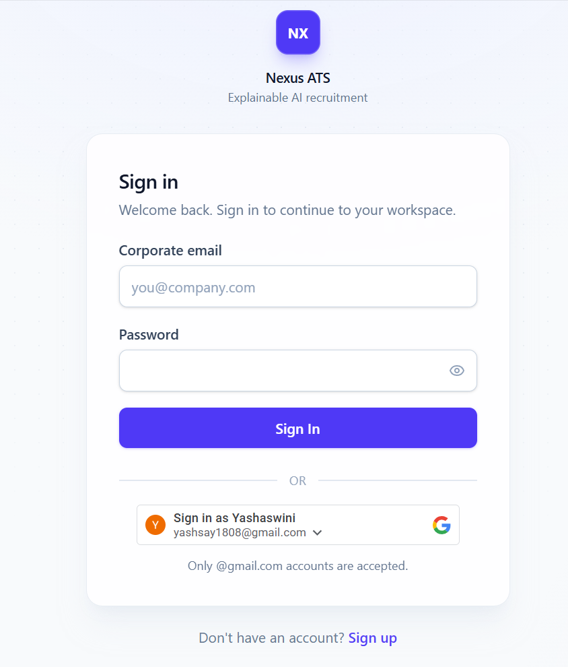
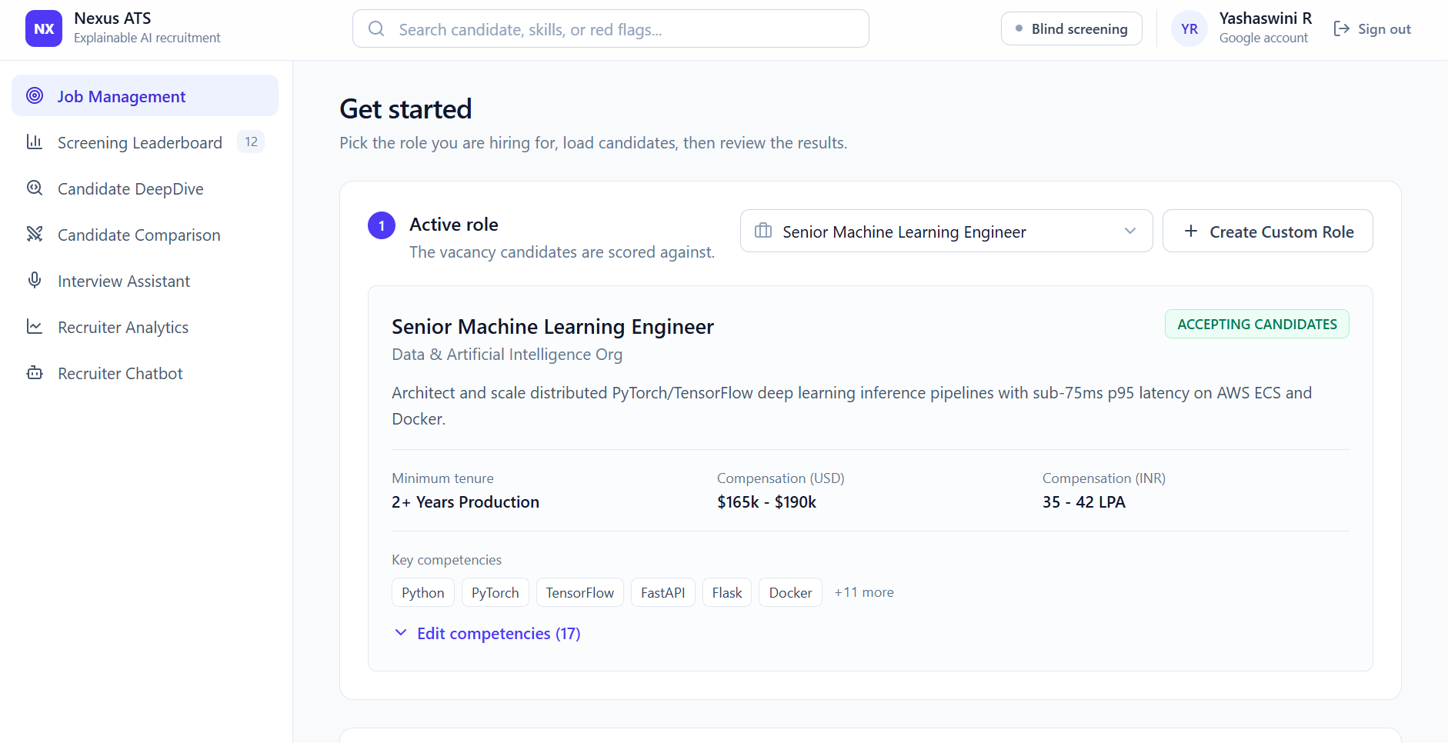
INTERFACE DESIGN
Sign-in (live site)
Job Management
DEPT OF ISE, VKIT

Slide 20
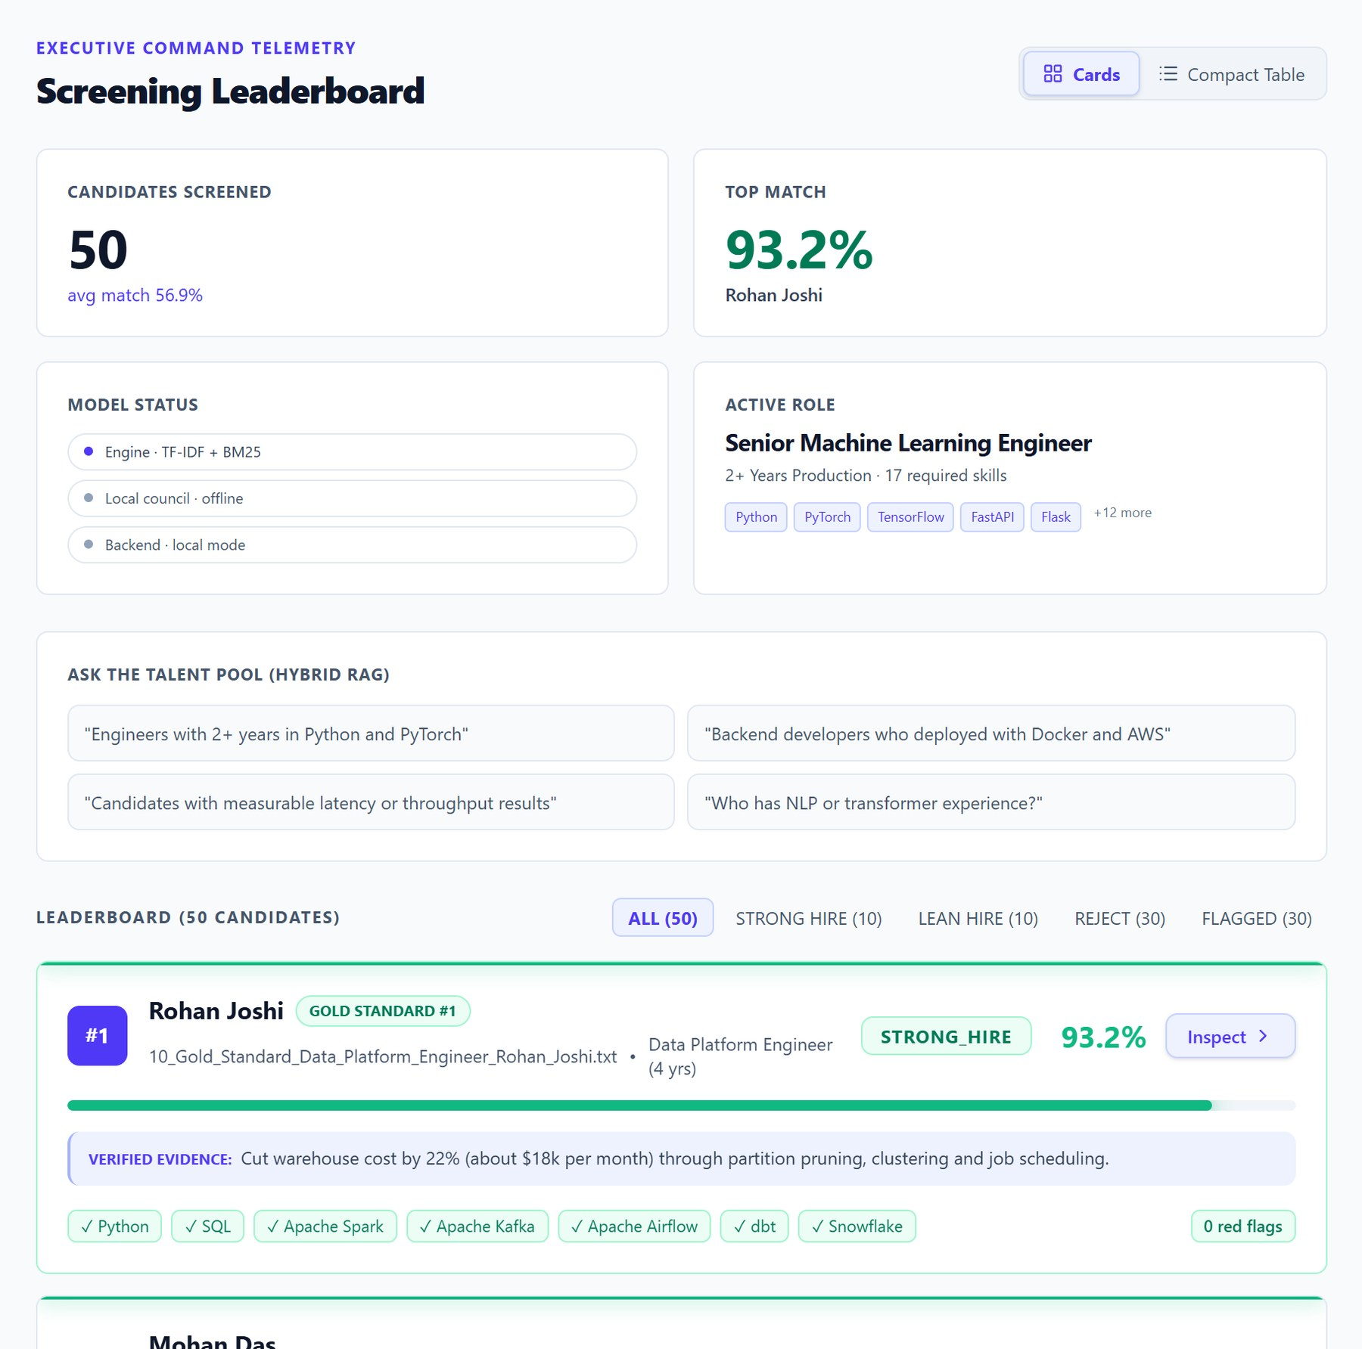
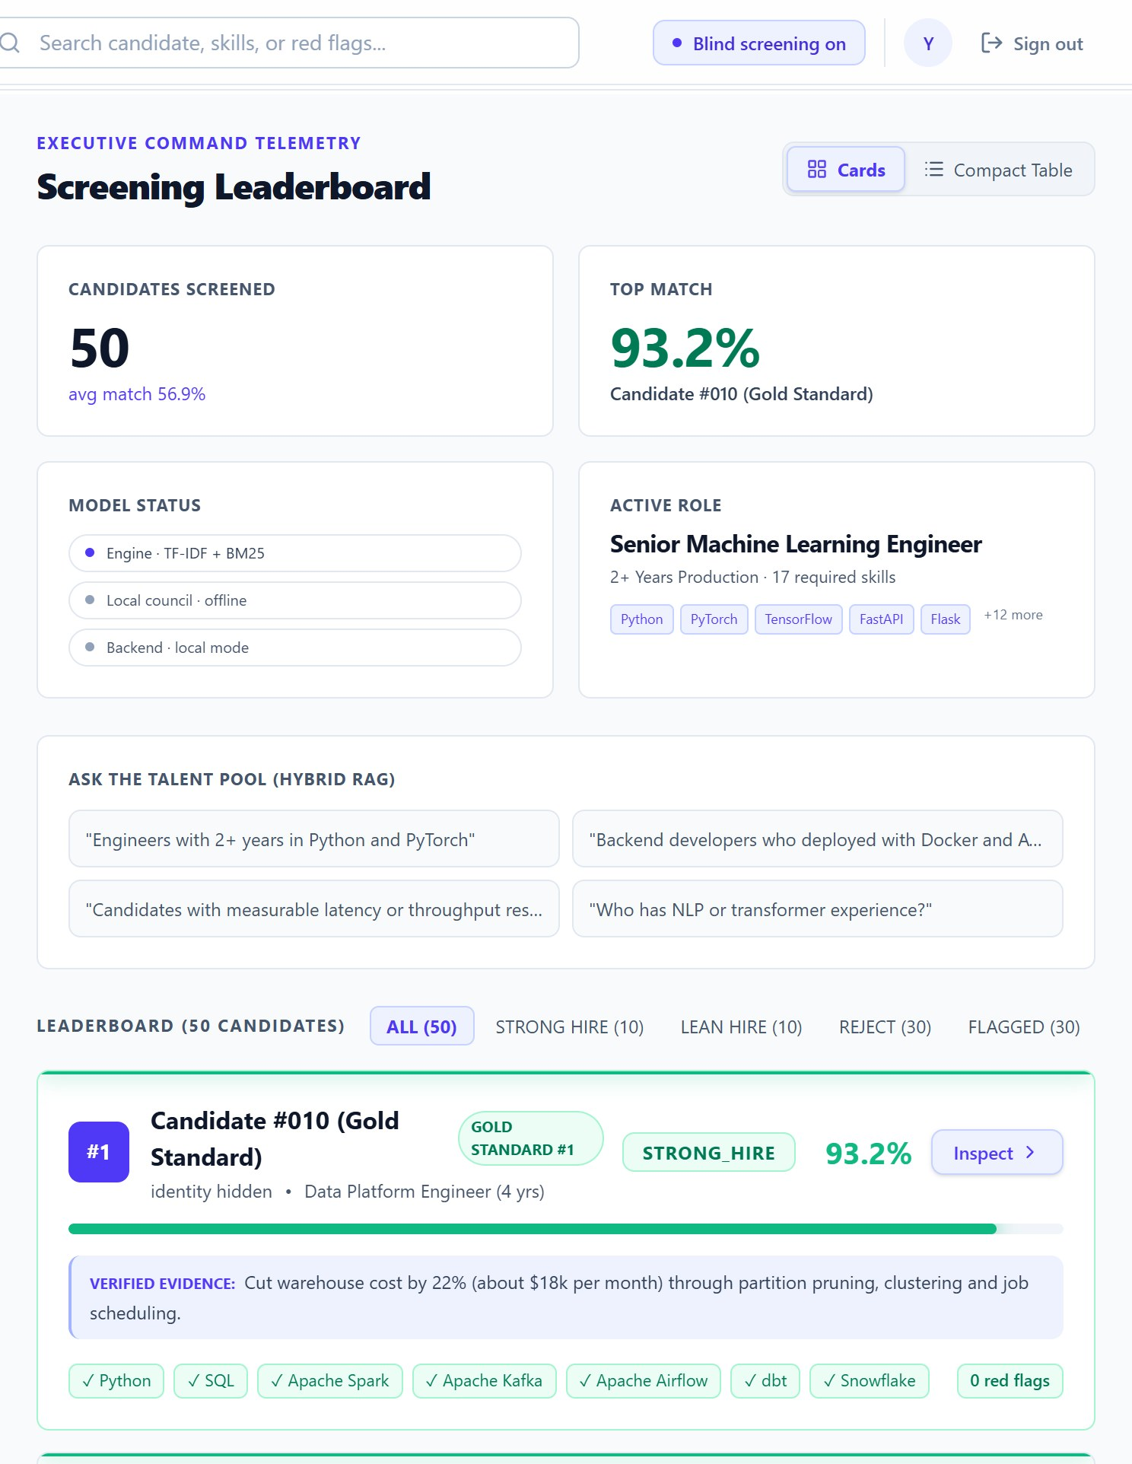
RESULTS (CONTD.)
(a) Leaderboard with verified evidence
(b) Blind screening on: identities hidden
DEPT OF ISE, VKIT

Slide 21
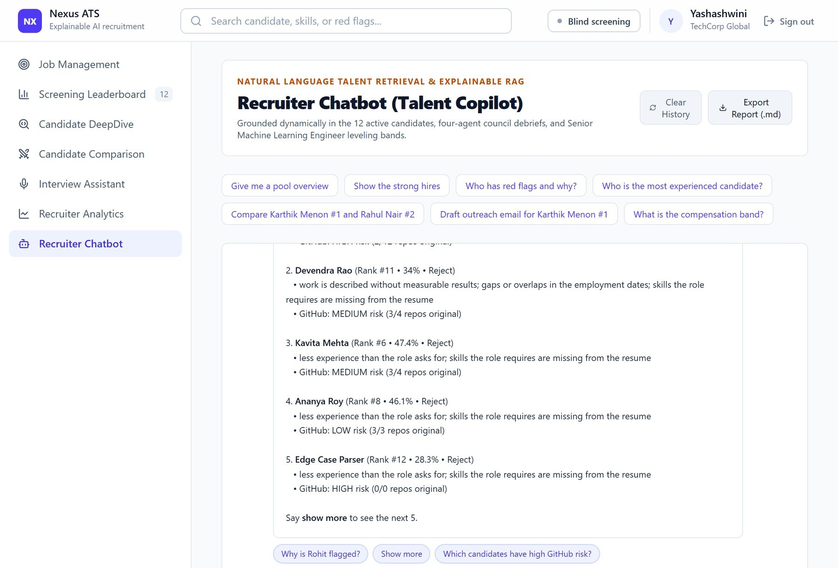
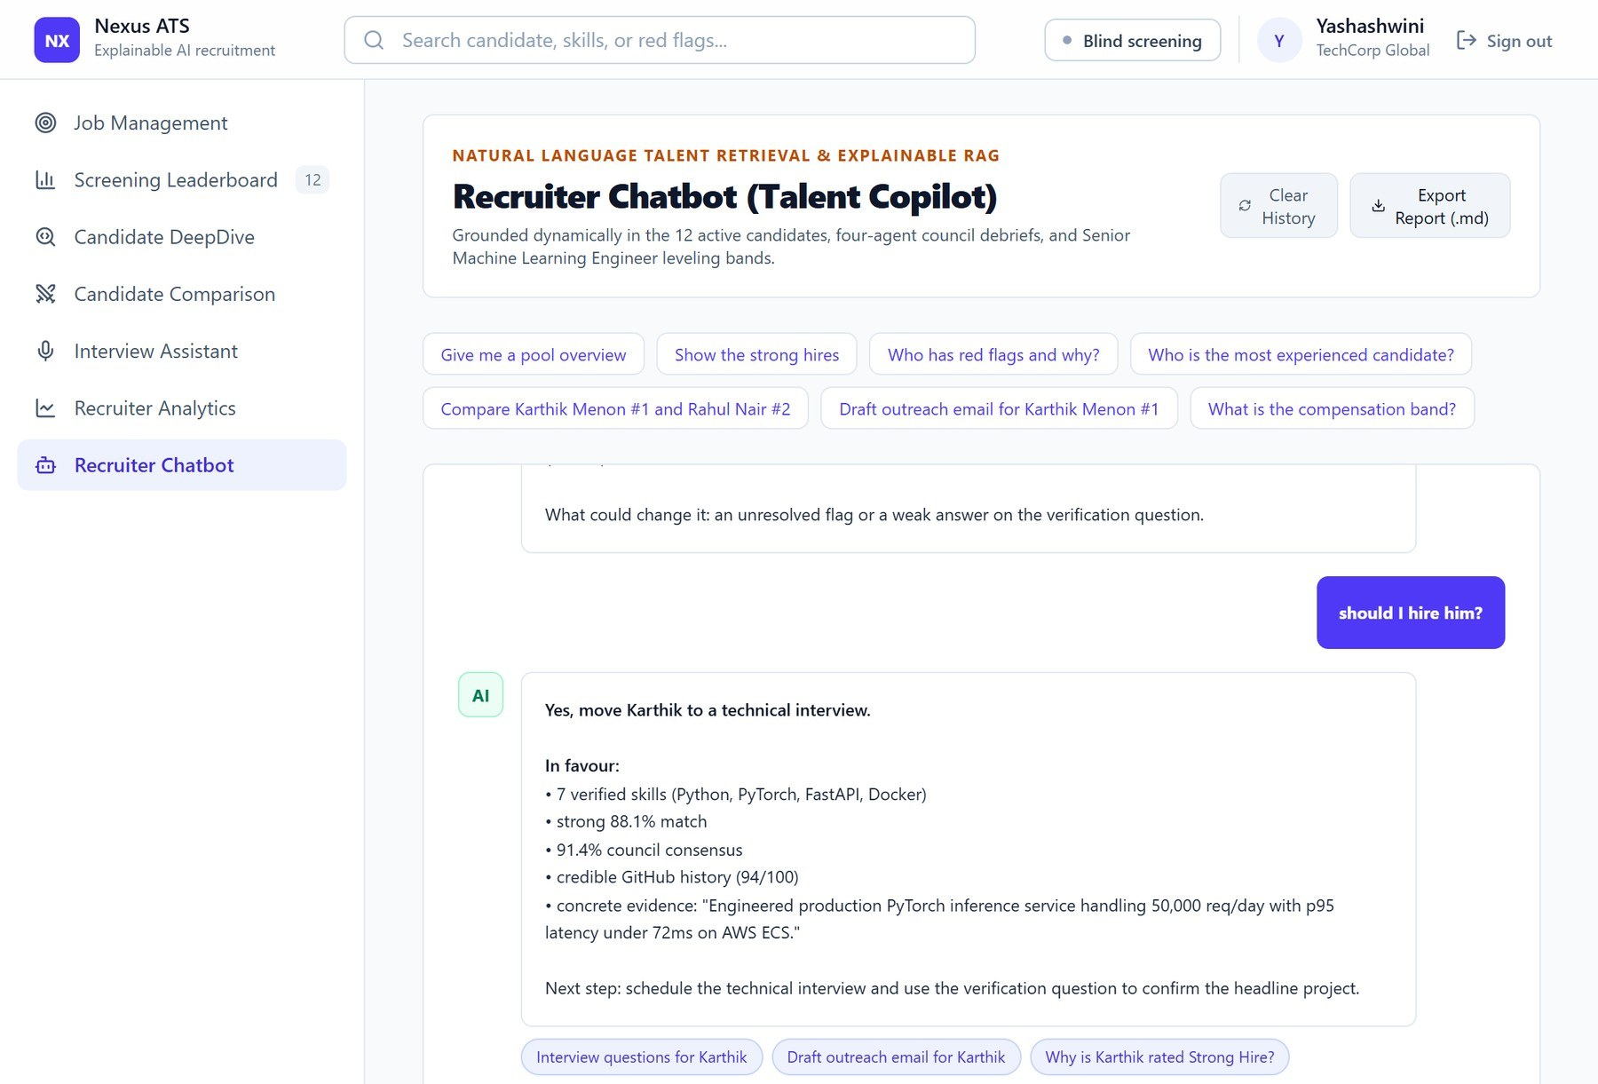
RECRUITER COPILOT
(a) Red-flag audit of the screened pool (b) Follow-up questions with clickable suggestions
DEPT OF ISE, VKIT

Slide 22
SPEED AND ROBUSTNESS
Fast: about 30 ms per resume end to end, fully offline.
Stable: over 200 random changes to the scoring weights, the top candidate stayed first in every run and the average rank correlation was 0.97.
Fair: swapping names changed no score, in plain or blind mode.
Evidence matters: removing evidence weighting turned two REJECT verdicts into LEAN HIRE.
Different from Phase 1: rank correlation with the keyword baseline is only 0.67, so the ranking really changed.
DEPT OF ISE, VKIT

Slide 23
BENCHMARK POOL OF 50 RESUMES
50 synthetic resumes of different types were screened for the Senior Machine Learning Engineer role.
Top match: 93.2%, the gold-standard Data Platform Engineer with zero red flags.
Average match: 56.9% across the pool.
Verdicts: 10 Strong Hire, 10 Lean Hire and 30 Reject; 30 resumes carried at least one red flag.
DEPT OF ISE, VKIT

Slide 24
CONCLUSION
The AI-Powered Intelligent Recruitment System shows that resume screening can be fast, explainable and fair at the same time. It ranks candidates on seven weighted signals instead of simple keyword counts, understands related skills through a skill ontology, and hides identity details through blind screening before anyone is scored.
Every decision comes with a verdict, red flags and a reason, so recruiters can justify it. In testing, the system placed the strong candidate first and rejected resumes with inflated or badly formatted content, while processing each resume in about 30 milliseconds. Changing a candidate's name did not change any score. The system is also deployed as a multi-user web service with server-side authentication and a managed database.
Overall, the project shows that explainable AI can make hiring more transparent, consistent and trustworthy.
DEPT OF ISE, VKIT

Slide 25
FUTURE SCOPE
The deployed system can be extended with role-based access, candidate consent and data-retention controls, and a stored screening history for each account.
A larger set of labelled real hiring data can be used to validate and tune the scoring weights, and the evidence checks can be extended to LinkedIn, portfolios and resumes in more languages.
Email and ATS integrations and a load test would prepare it for production use.
DEPT OF ISE, VKIT

Slide 26
REFERENCES
[1] M. Zehlike, "FA*IR: A fair top-k ranking algorithm," ACM CIKM, 2017.
[2] C. Qin, "Enhancing person-job fit for talent recruitment: An ability-aware neural network approach," ACM SIGIR, 2018.
[3] N. Reimers and I. Gurevych, "Sentence-BERT: Sentence embeddings using Siamese BERT-networks," EMNLP-IJCNLP, 2019.
[4] V. Bhatia, P. Rawat, A. Kumar, and R. R. Shah, "End-to-end resume parsing and finding candidates for a job description using BERT," arXiv:1910.03089, 2019.
[5] M. Raghavan, S. Barocas, J. Kleinberg, and K. Levy, "Mitigating bias in algorithmic hiring: Evaluating claims and practices," ACM FAT*, 2020.
[6] C. Qin, "A comprehensive survey of artificial intelligence techniques for talent analytics," arXiv:2307.03195, 2023.
[7] Y. Du, "Improving factuality and reasoning in language models through multiagent debate," ICML, 2024.
[8] L. Armstrong, A. Liu, S. MacNeil, and D. Metaxa, "The silicon ceiling: Auditing GPT's race and gender biases in hiring," arXiv:2405.04412, 2024.
[9] K. Wilson and A. Caliskan, "Gender, race, and intersectional bias in resume screening via language model retrieval," AAAI/ACM AIES, 2024.
[10] A. Deshmukh and A. R. Dahake, "Comparing BERT and Sentence-BERT for automated resume screening," IAES Int. J. Artif. Intell., vol. 14, no. 4, 2025.
DEPT OF ISE, VKIT

Slide 27
THANK
YOU!
DEPT OF ISE, VKIT

